Slide 1


IMS System – Aurimas Pilnikovas

Slide 2

I’m Aurimas
A trainee at QA academy.
I’m a computer science graduate with a hobby for programming/networking

Slide 3
IMS Project:
In this project I was tasked to add functionality to an unfinished implementation of a CRUD program, dealing with customers, items and orders and to deliver a Minimum Value Product.
I’ve approached this task by first gaining an understanding the user requirements of such a program by putting myself in the position of the user, since requirements are not very detailed I had to use my own intuition for certain functionality and what the program should be able to do.
The second thing I did was looked at the given code and understanding the general structure that the rest of the program should follow.

Slide 4
What technologies have I learned?
The project contained technologies that I’ve not encountered before, namely:
JUNIT, Mockito, JDBC and Maven.
This project was an excellent opportunity for me to familiarize with these tools. JUNIT in particular was quite challenging.
I’ve also gained a deeper understanding of SQL and how relational databases work.

Slide 5
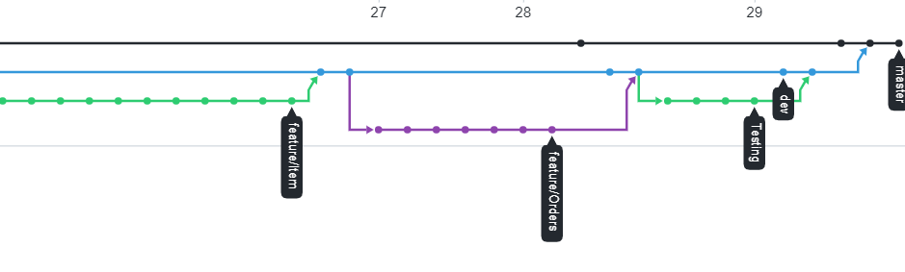
Version Control
For version control I’ve used Git and Github.
I used a feature branch model to separate different functions and merge branches when that feature was completed.
I’ve used Maven as a build tool.

Slide 6
Testing
I’ve done most of the unit testing for Orders, Items and Customers, all integration testing for Customers and Items and about half of integration for orders.
I’ve not tested some methods in order that are utility methods that I ended up not using but chose to keep for future releases.
I’ve also not tested some methods related to updating/changing order items for the order as I’ve ran out of time.

Slide 7
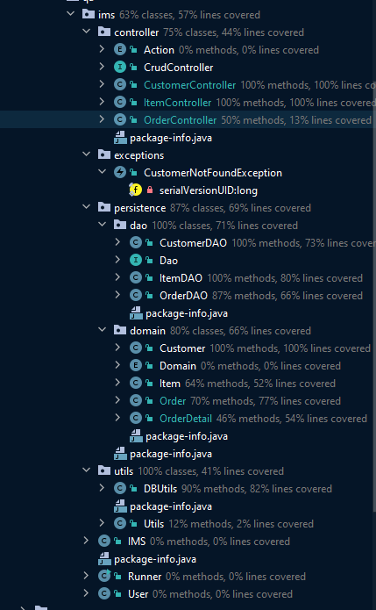
Coverage
Not tested some utility methods in Order and Item
Not tested utility classes
Missing half of order controller integration tests

Slide 8




User stories:

Slide 9
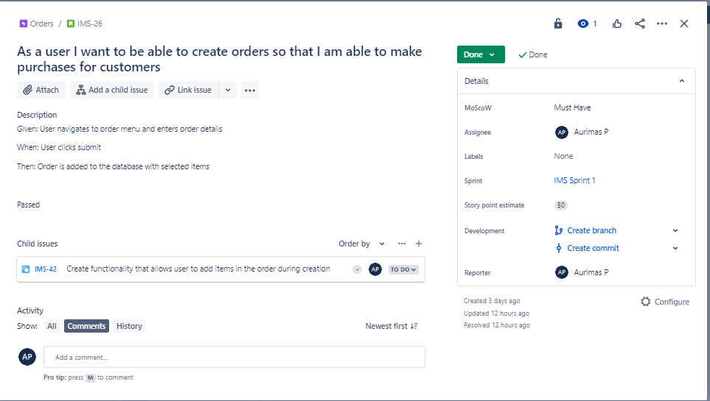
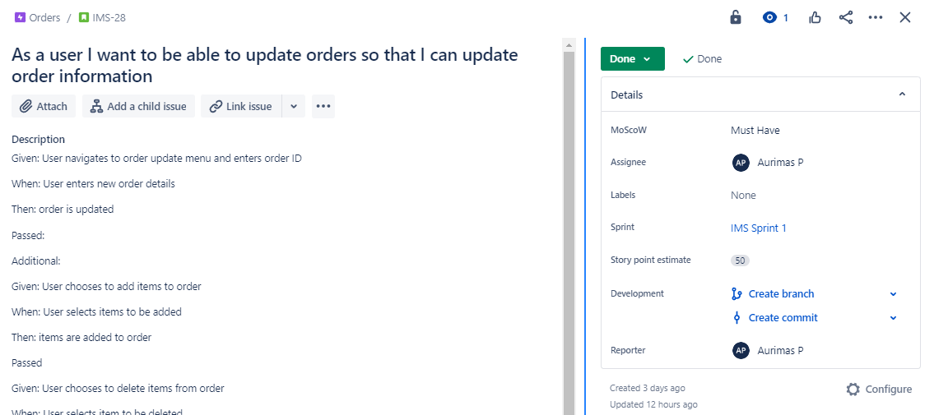
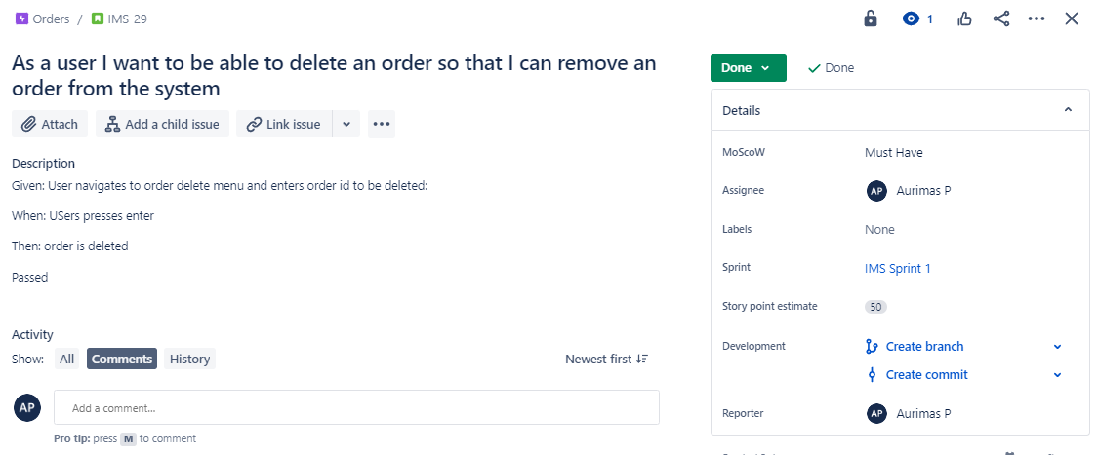
I’ve selected 3 user stories

Slide 10
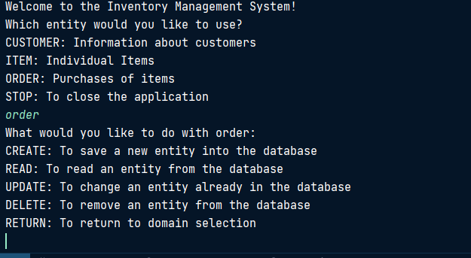
Creating an order
Firstly you would navigate to order menu by typing order.

Slide 11
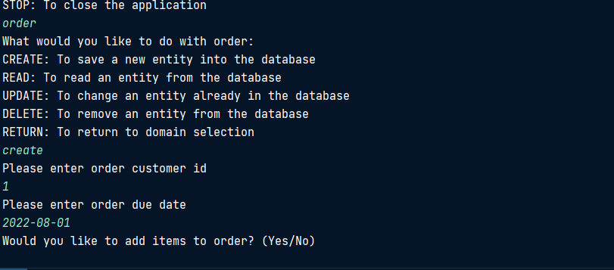
Enter details

Slide 12
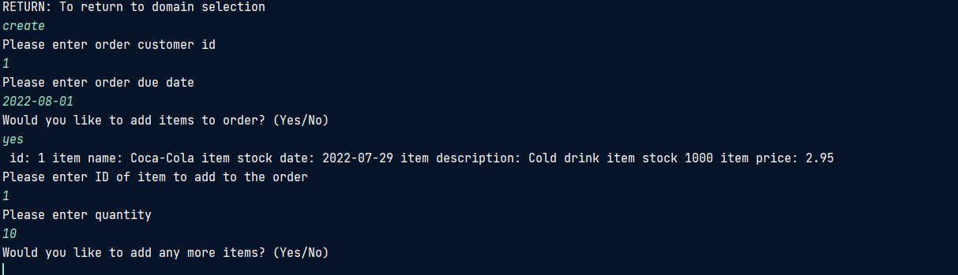
Adding items

Slide 13
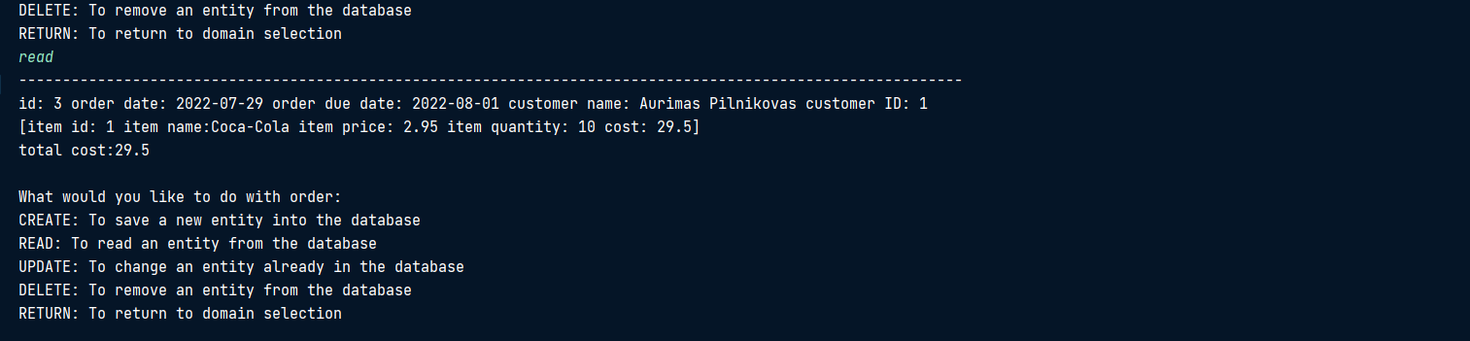
Order is created

Slide 14
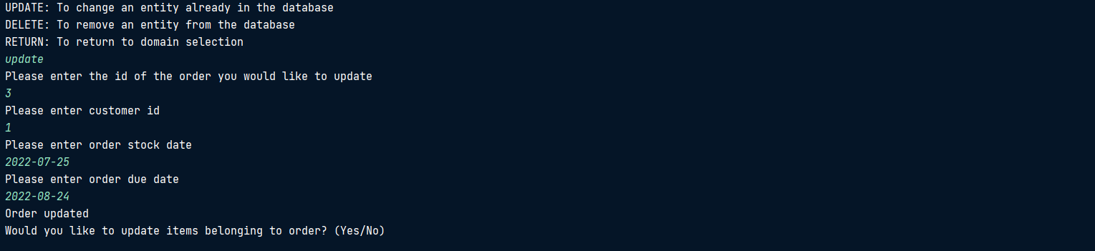
Updating order part 1:

Slide 15
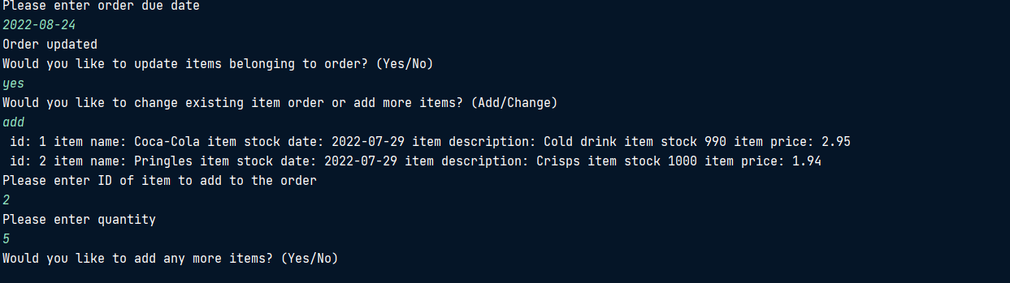
Updating order part 2:

Slide 16
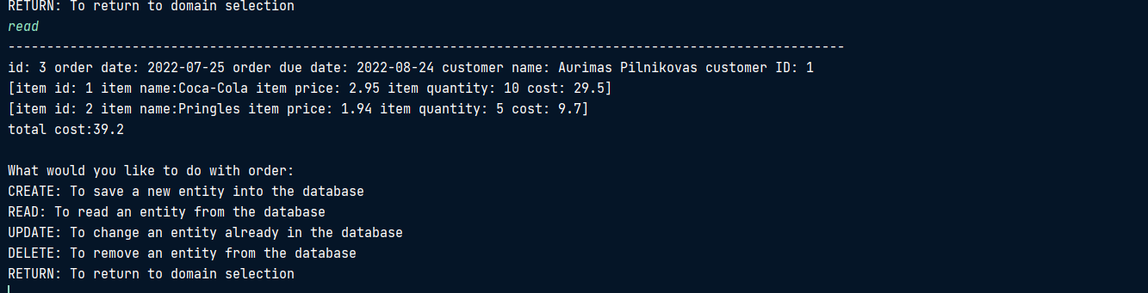
Updating order part 3:

Slide 17
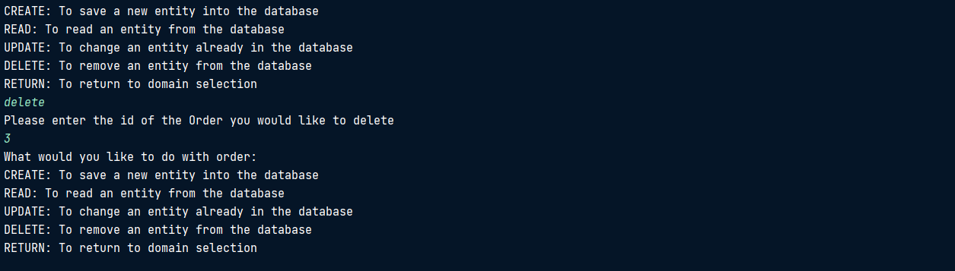
Deleting an order

Slide 18
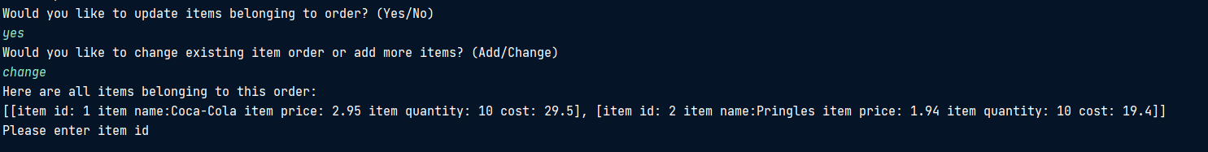
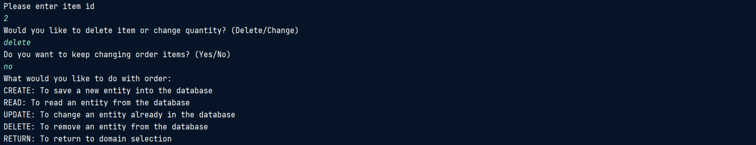
Removing items from the order

Slide 19
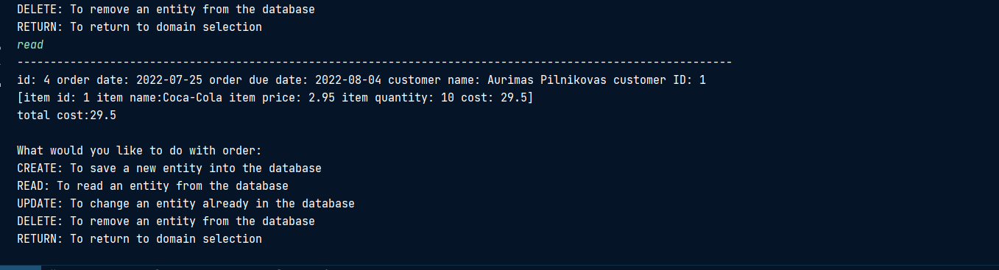
Item removed

Slide 20
Sprint review:

Slide 21
What’s done?
You can add, delete, change orders, items, customers and items belonging to specific order quite seamlessly.
The main functionality is complete and what I want the program to do.
Most of the testing is done.

Slide 22
What’s left?
Complete tests to get higher coverage.
Unfortunately items do not get re-added in the database when order is updated. So if you remove an item from a specific order, the quantity does not get released back. This shouldn’t be difficult to do.
Data validation (making sure the user enters a valid name for example) which I marked as Won’t Have is not done.

Slide 23
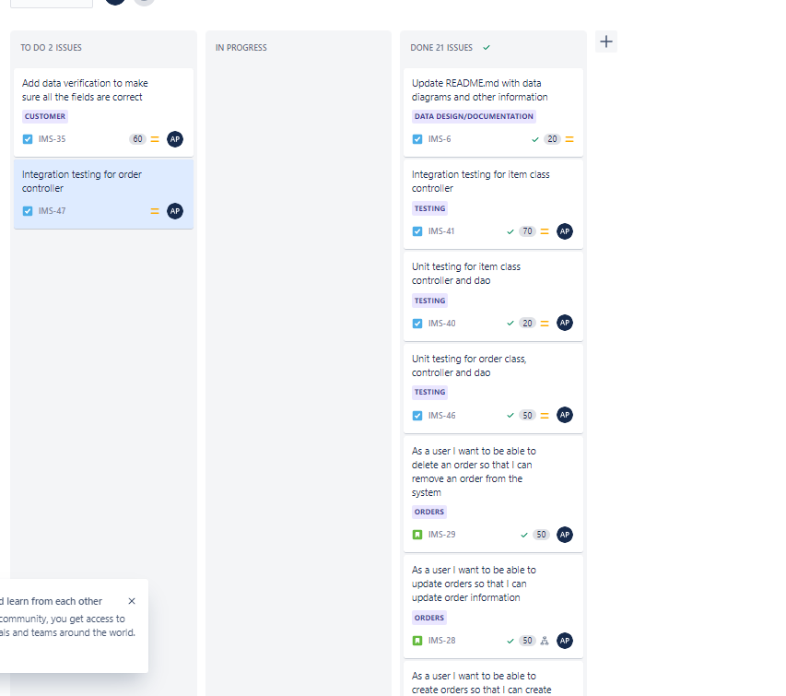
Backlog

Slide 24
What went well?
The design “phase” went pretty well, I knew what I wanted to do and how it should be done.
I like how the program functions, it keeps to the same design pattern.
Updating orders work pretty well.

Slide 25
What went wrong?
The program was confusing at first, if I was building the project from scratch I’d probably have done it differently. I think it added unnecessary complication.
Testing was quite challenging, comparing object equality was not as straightforward as I thought.
Did not have time to complete certain functionality such as items being released from order, users and testing.

Slide 26
Future steps:
Finish all the functionality,
Improve graphics, I was thinking of using a table plugin that’d display records in a cool text table but wasn’t sure if it was allowed.
Get more coverage.

